Slide 1

Sports India
A Major Project Work
Submitted in 7th Semester of Bachelor of Technology (B. Tech)
In
Computer Science & Engineering (Session: 2017-2021)
Under the Guidance of
Prof. SHITANSHU SONANKIYA
Submitted By Submitted to
Ritik-0228CS171032 (Teamleader) Prof. Nitin Shukla
Jashvant-0228CS171012 Head of Dept. CSE SRGI
DEPARTMENT OF COMPUTER SCIENCE & ENGINEERING
Shri ram Institute of Technology, Jabalpur (M.P.)
Rajiv Gandhi Proudyogiki Vishwavidyalaya, Bhopal (M.P.)

Slide 2
To-do App

Slide 3
Problem Statement
Project Name - To-Do App
Problem Statement- Help to become more aware how to spend time
Category - Website
Team Leader- Ritik Patel
Members Name- Ritik Patel

Slide 4
System Requirment
Windows 10
Tomacat9.0
My SQL 8.0
Java SE 10 or higher version

Slide 5
Introduction

Slide 6
What is To-Do App ?
It is a web-app simple to use to-do list app that can help you plan, track, and get more tasks done.
You can create unlimited tasks, set status, give due dates,create to-do list items in tasks and assign them separately to team members.
Help to set constraints on social media to reduce distraction and track the time

Slide 7
Aim
Accomplish what's meaningful and important to you each day with My Day and Suggestions, your personalized daily planner tools. Intelligent suggestions recommend tasks from across your lists that may be relevant for the day. From grocery lists to housecleaning routines, daily tasks are simple with To Do. When you're quickly switching between contexts and tasks, it's important to have tools that help you achieve what matters.

Slide 8
Features
A daily planner personalized with suggested tasks: My Day
• To do lists are accessible anywhere, on any device
• Share lists and assign tasks with your friends, family, colleagues, and classmates
• Task management features break your tasks into manageable steps
• Take notes to add to any task
• Group lists together by topic or project

Slide 9
Future Enhancement
Add reminders, tasks and lists with the To Do widget
• Daily organizer personalized with bold and colorful backgrounds
• Reminders with one-time or recurring due dates
• Make task lists and switch between school, work, and personal lists

Slide 10
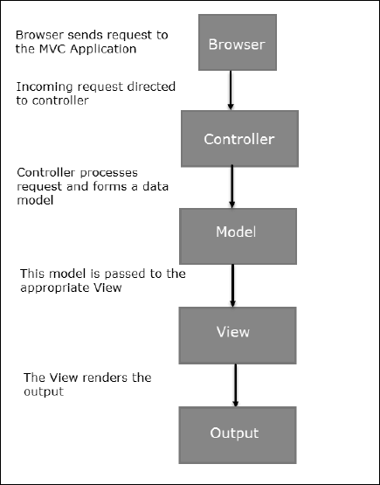
Flow Chart

Slide 11
Screenshot

Slide 12
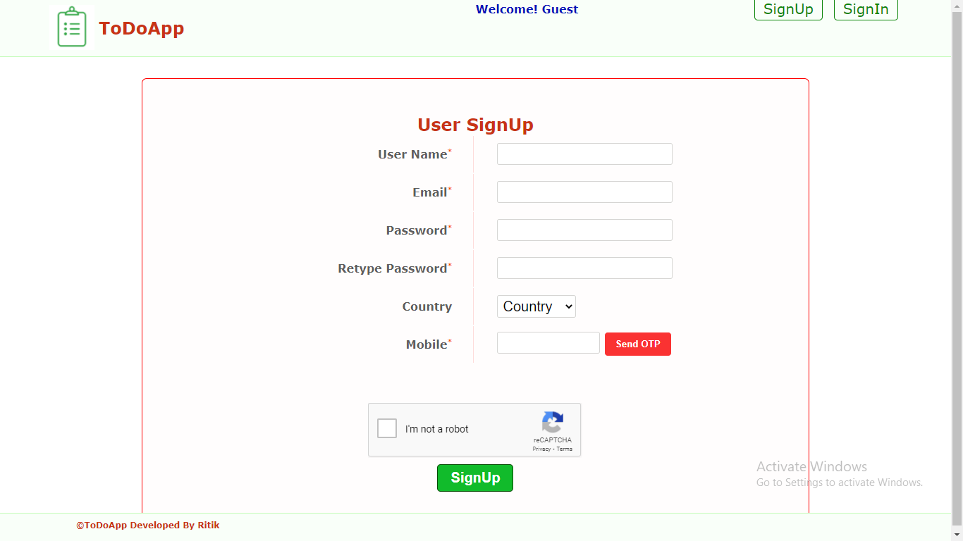

Slide 13
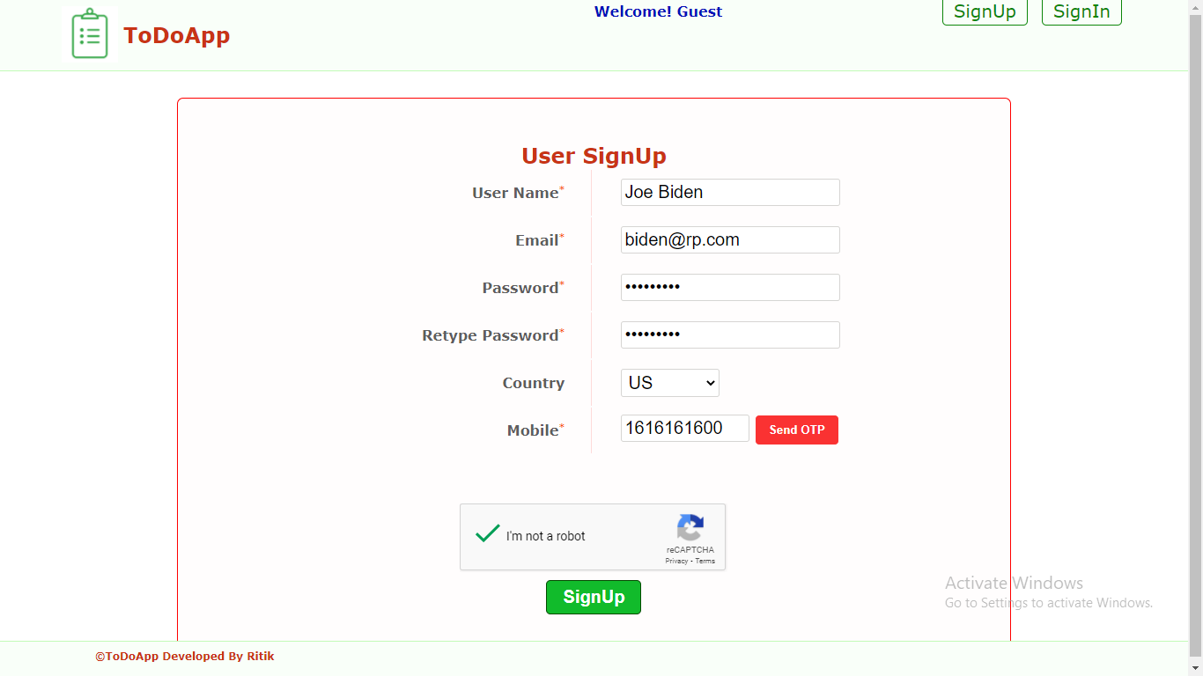

Slide 14
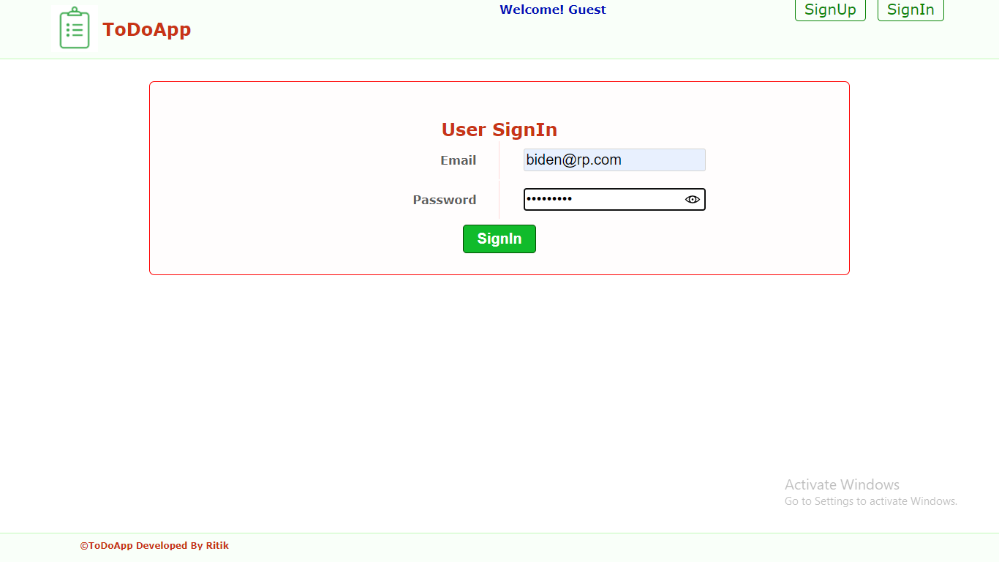

Slide 15
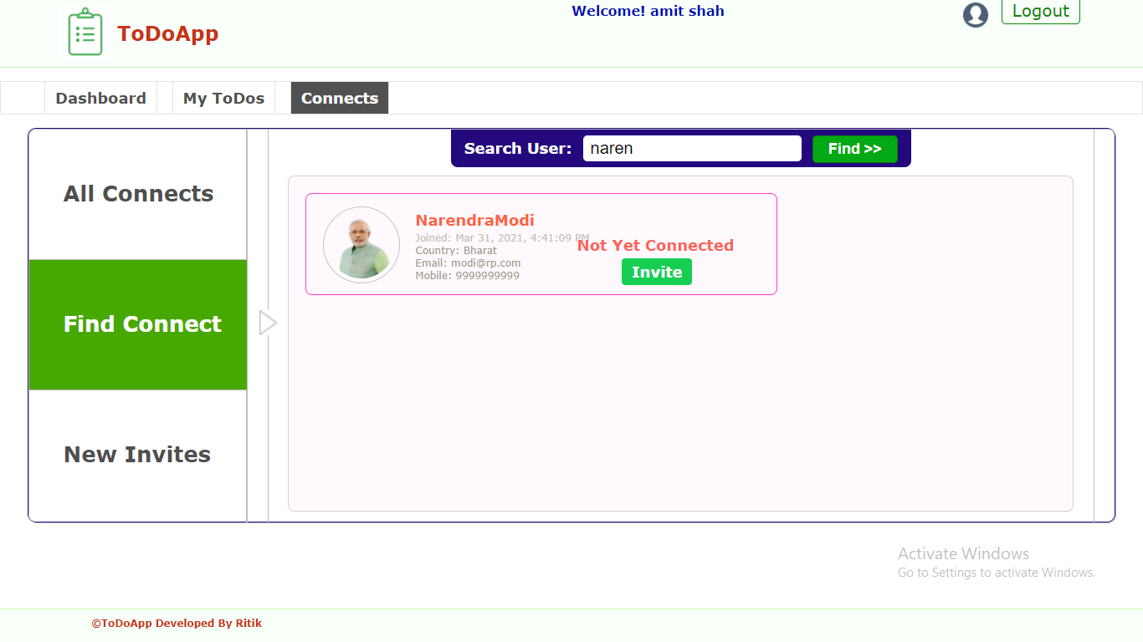

Slide 16
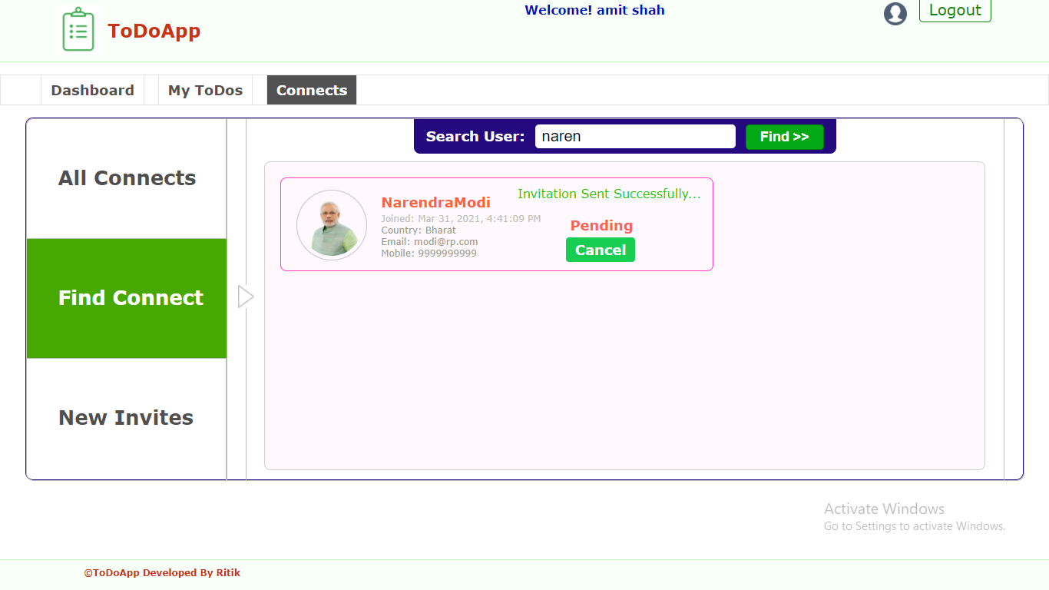

Slide 17
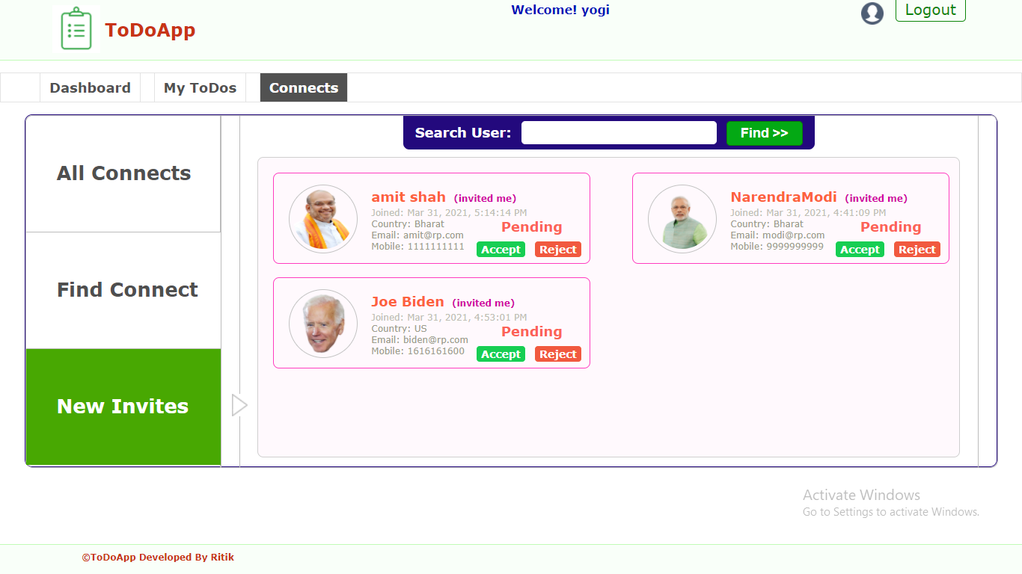

Slide 18
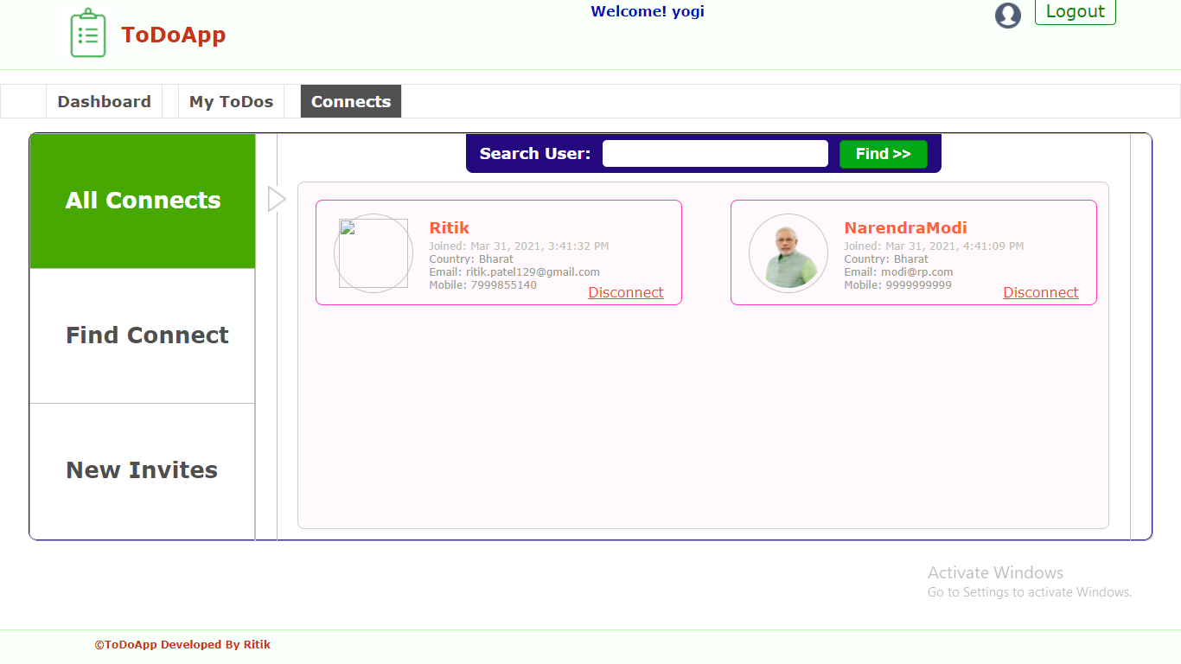

Slide 19
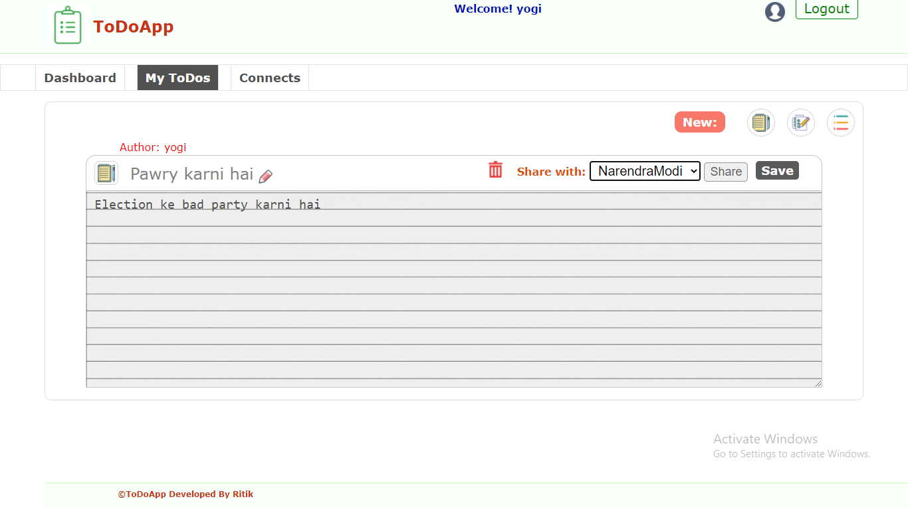

Slide 20
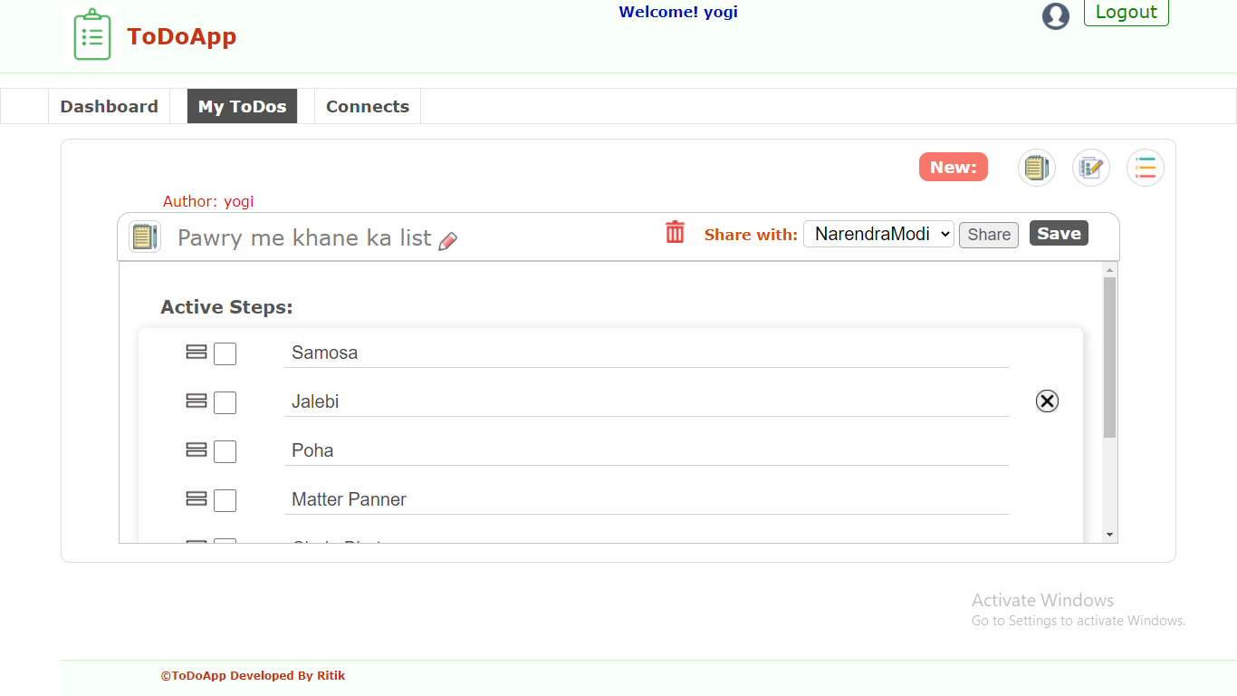

Slide 21
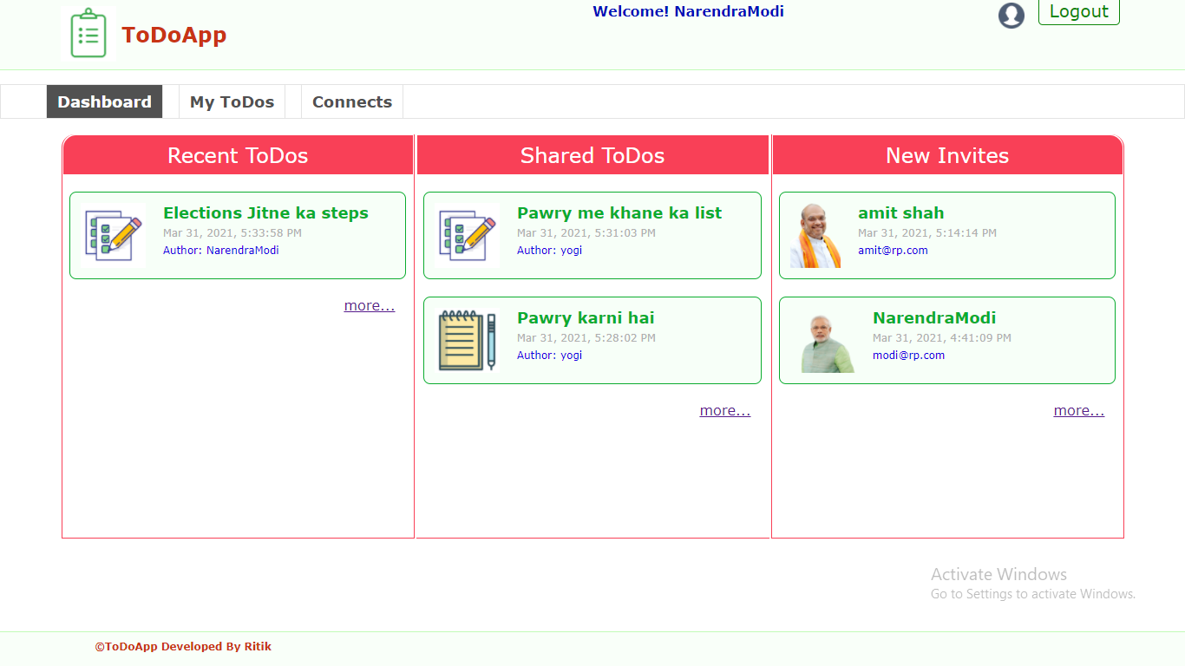

Slide 22
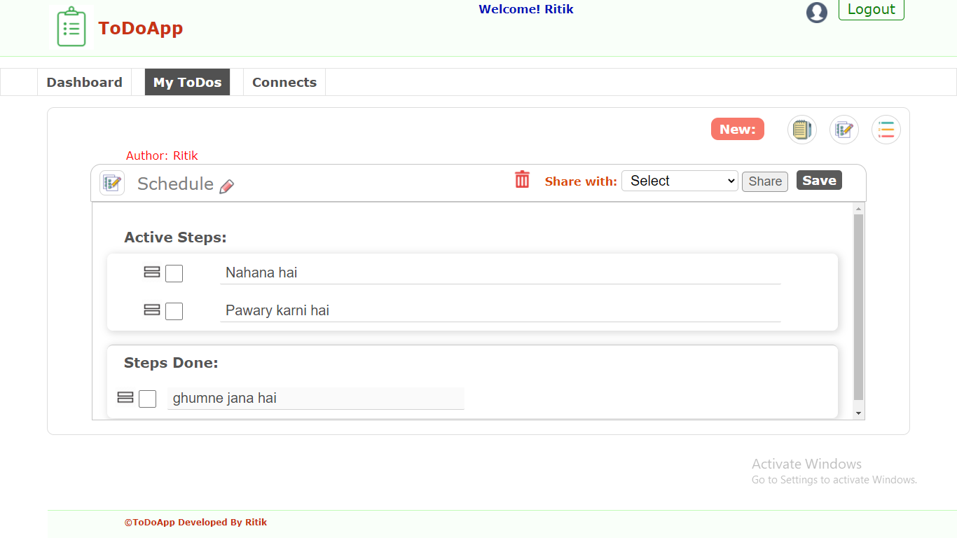

Slide 23
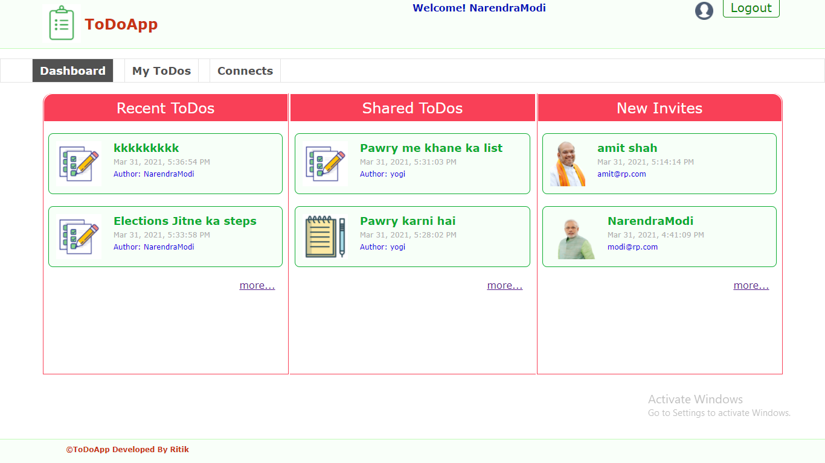

Slide 24
Programming

Slide 25
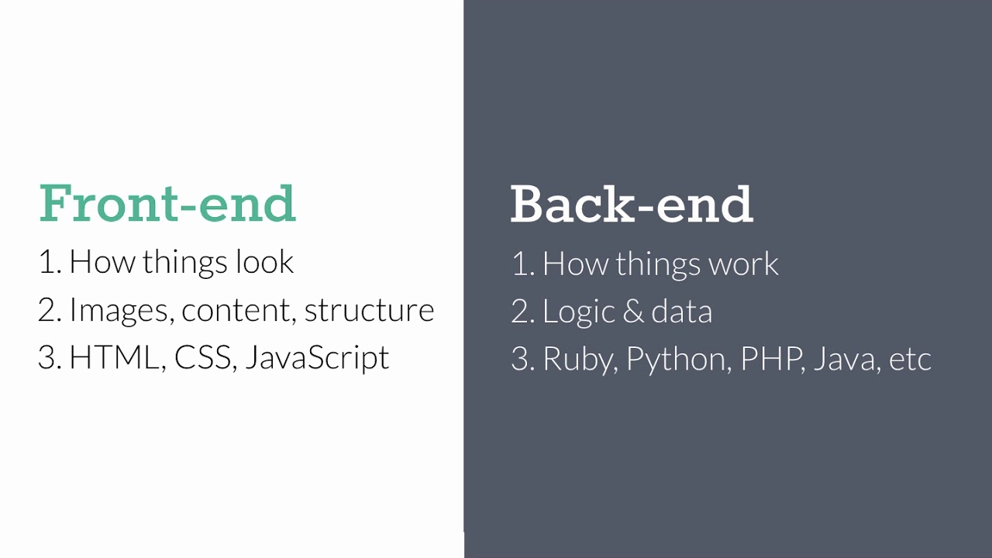

Slide 26
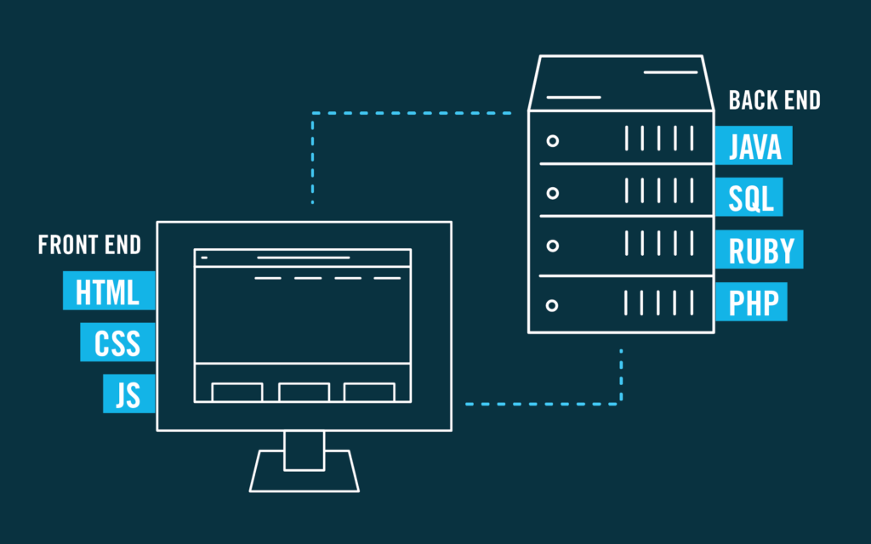

Slide 27
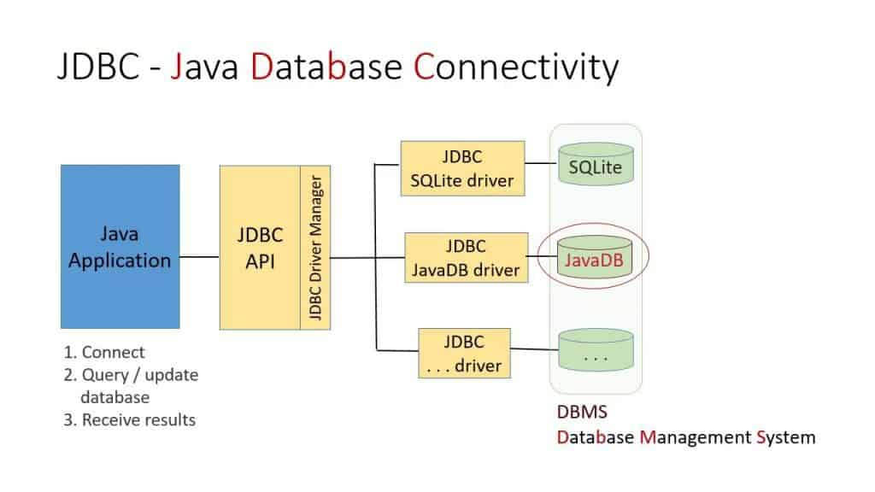

Slide 28
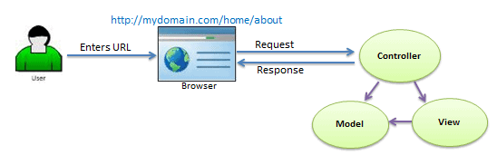

Slide 29
Query Thank you....!

